Slide 1
Internet stvari i servisa
Filip Dojčinović
18135

Slide 2
Sadržaj
Sensor
Analytics
EventInfo
Docker
Primer

Slide 3



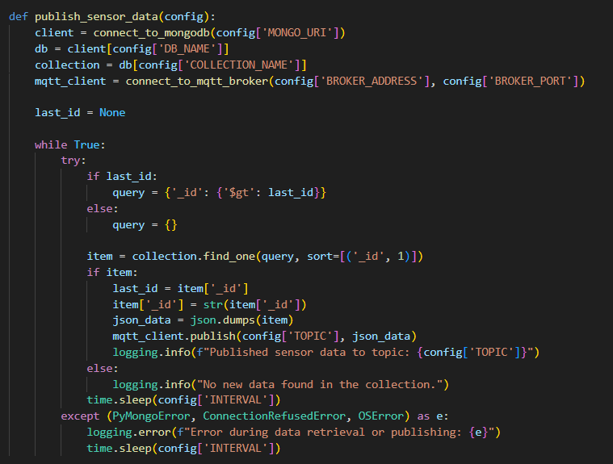


Sensor microservice
Retrieve data
publish ‘’sensor/data’’
MQTT Broker

Slide 4
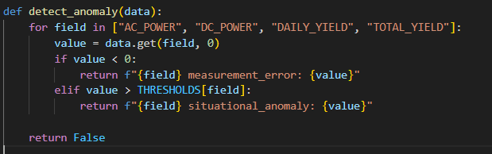
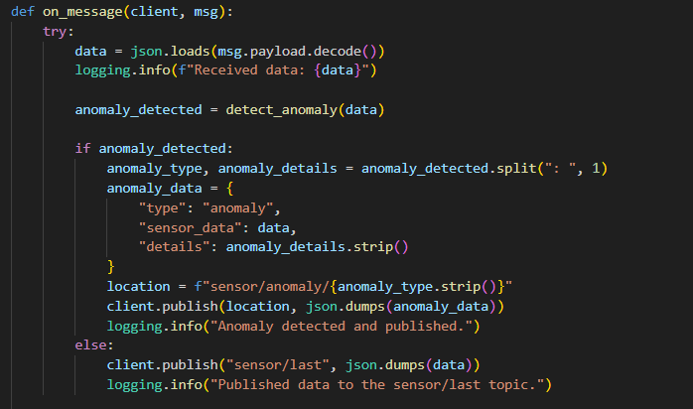
Analytics Microservice
Subscribe
sensor/data
Publish
sensor/last
Publish
Sensor/anomaly/+
MQTT
Broker

Slide 5
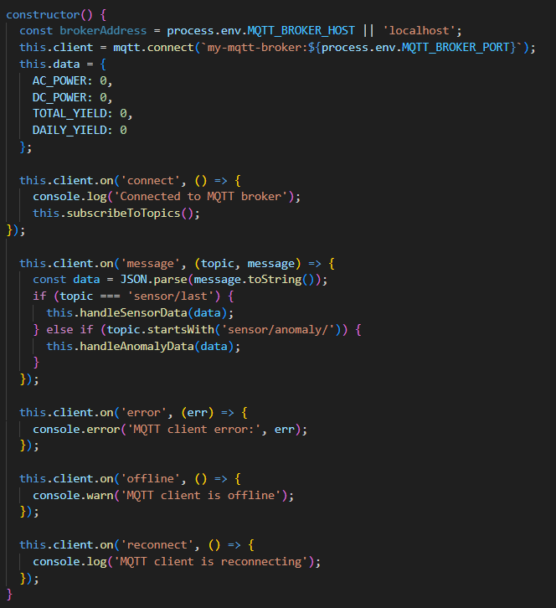
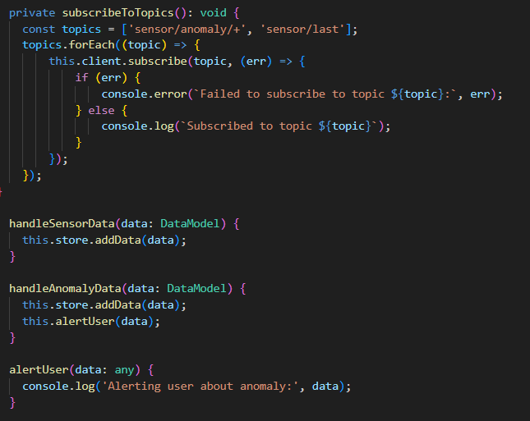
EventInfo

Slide 6
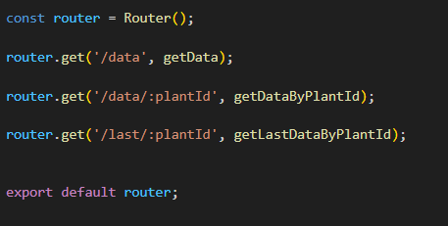
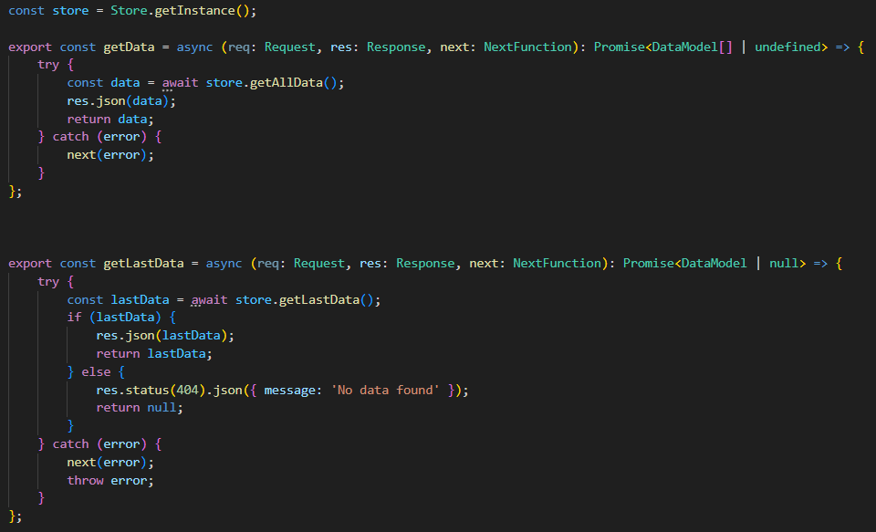
EventInfo

Slide 7
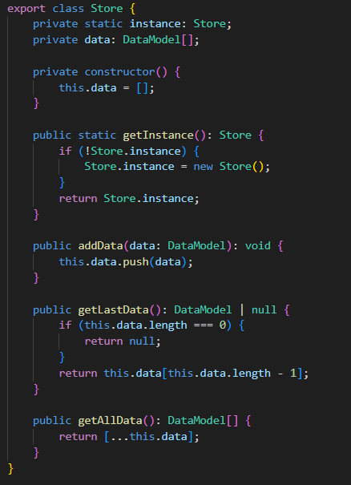
EventInfo
Singleton obrazac
Struktura slična rečniku
PlantId kao ključ
Koristi DataModel Interfejs

Slide 8
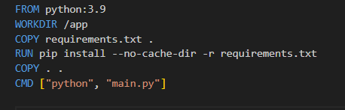
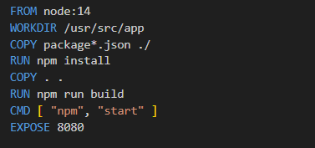
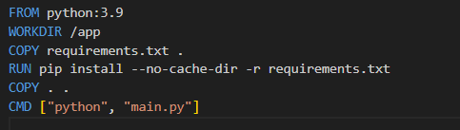
Docker docker images
Python-sensor
EventInfo
Analytics

Slide 9
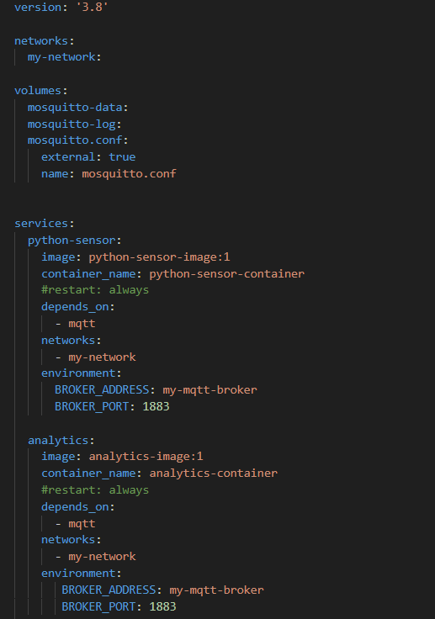
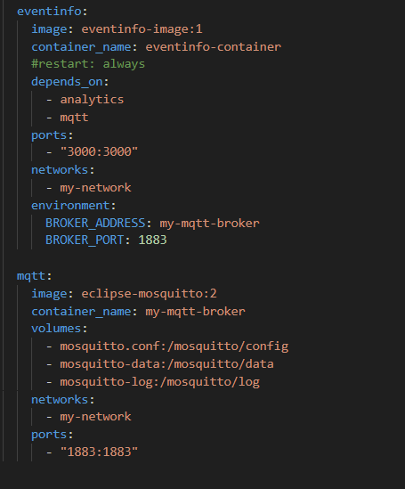
Docker docker compose

Slide 10
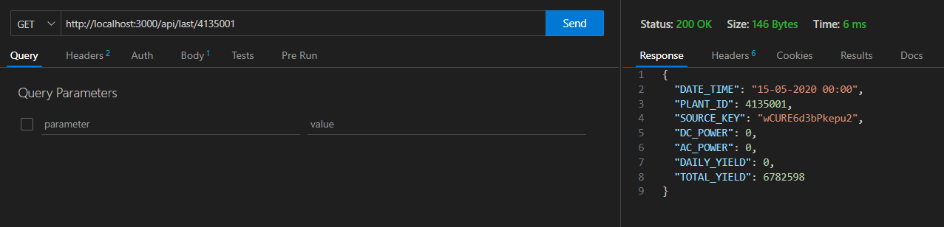
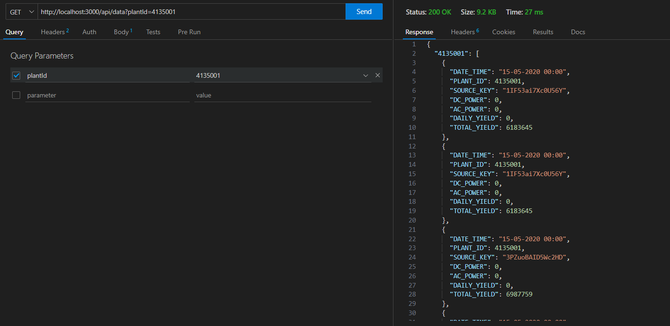
Rest API testing

Slide 11


